Slide 1
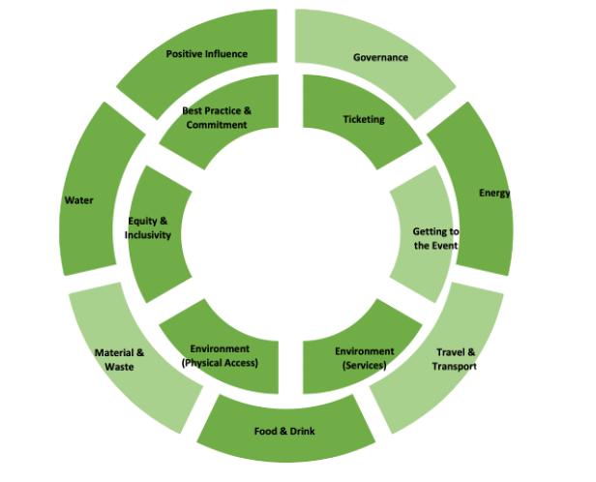
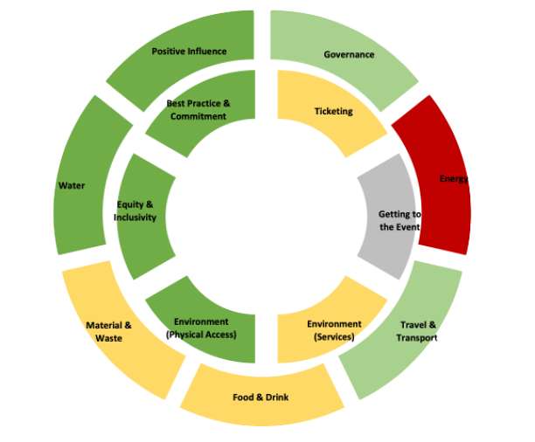
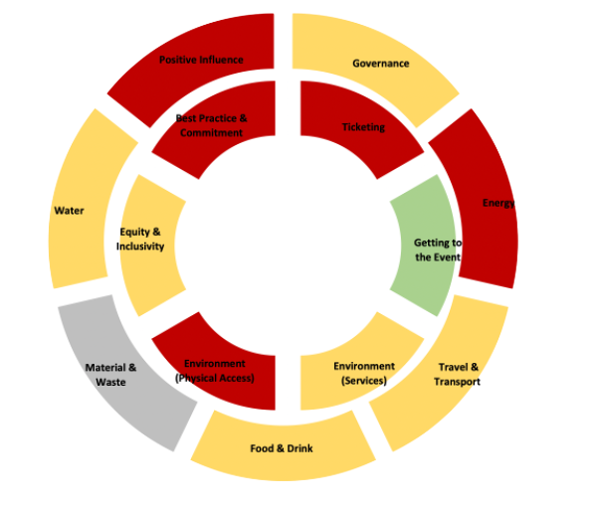
DATE: Donut Advisory Toolkit for Events
OAUK DATE Session 08/02/24

Slide 2
Overview of Toolkit
Demonstration
Questions

Slide 3
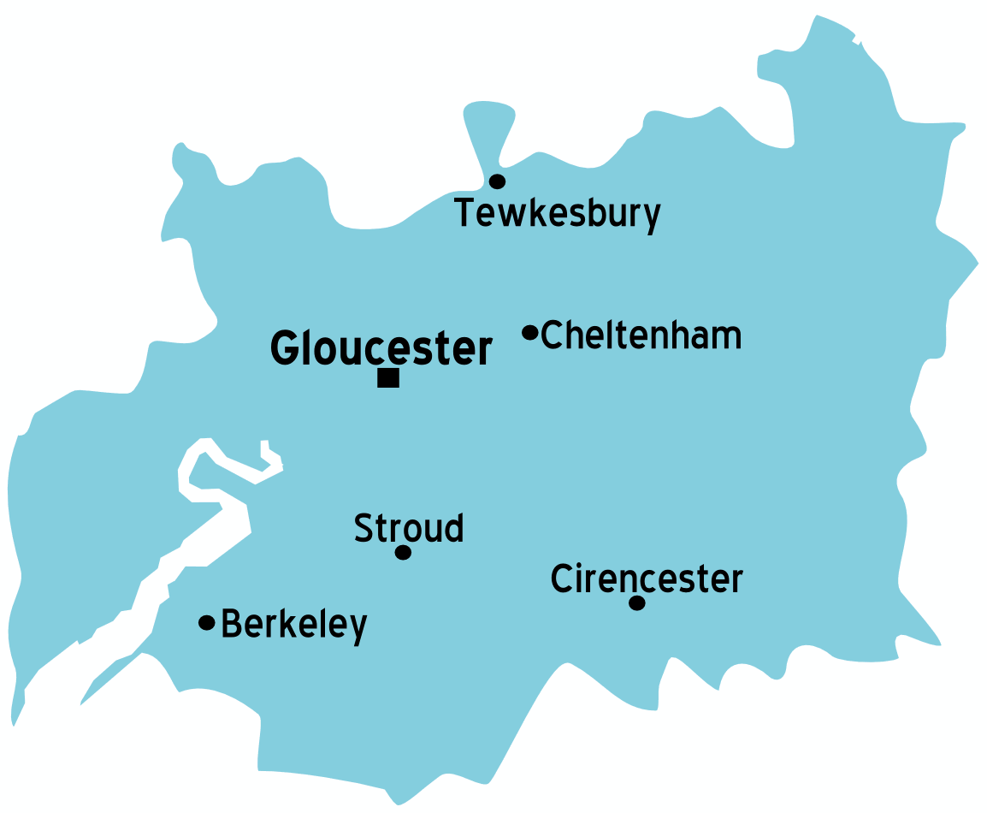
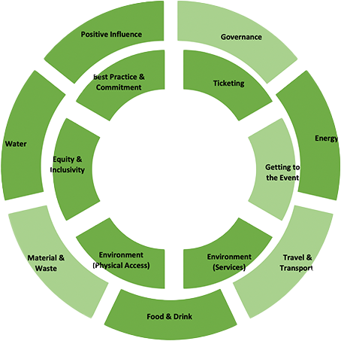
Overview
Advisory networks:
Cheltenham Culture Board
Economic Advisory Group
Sustainability Sub-Group
Local Stakeholders:
The DATE toolkit combines national community driven accessibility and sustainability standards into an assessment and advisory toolkit.
This has been made possible by the highly networked events research and practice ecosystem in Gloucestershire
Action
Research
Innovation
Inclusion
Local ecosystem for events accessibility & sustainability research

Slide 4
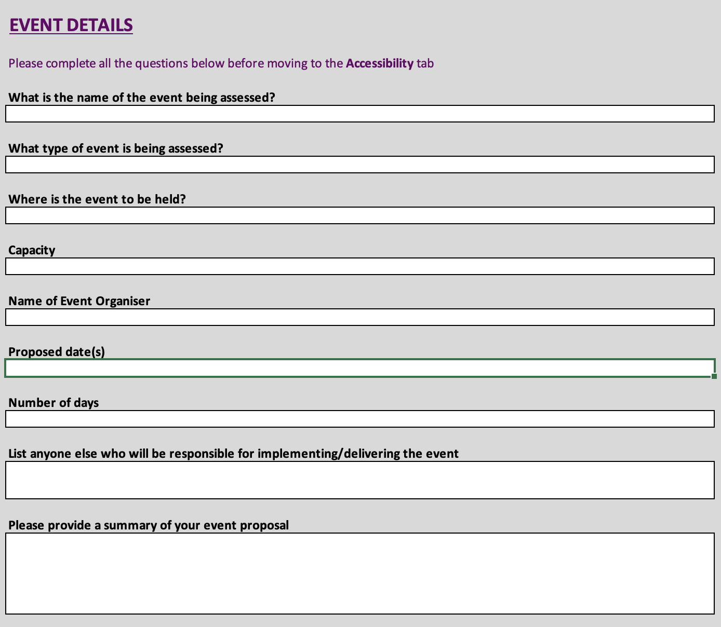
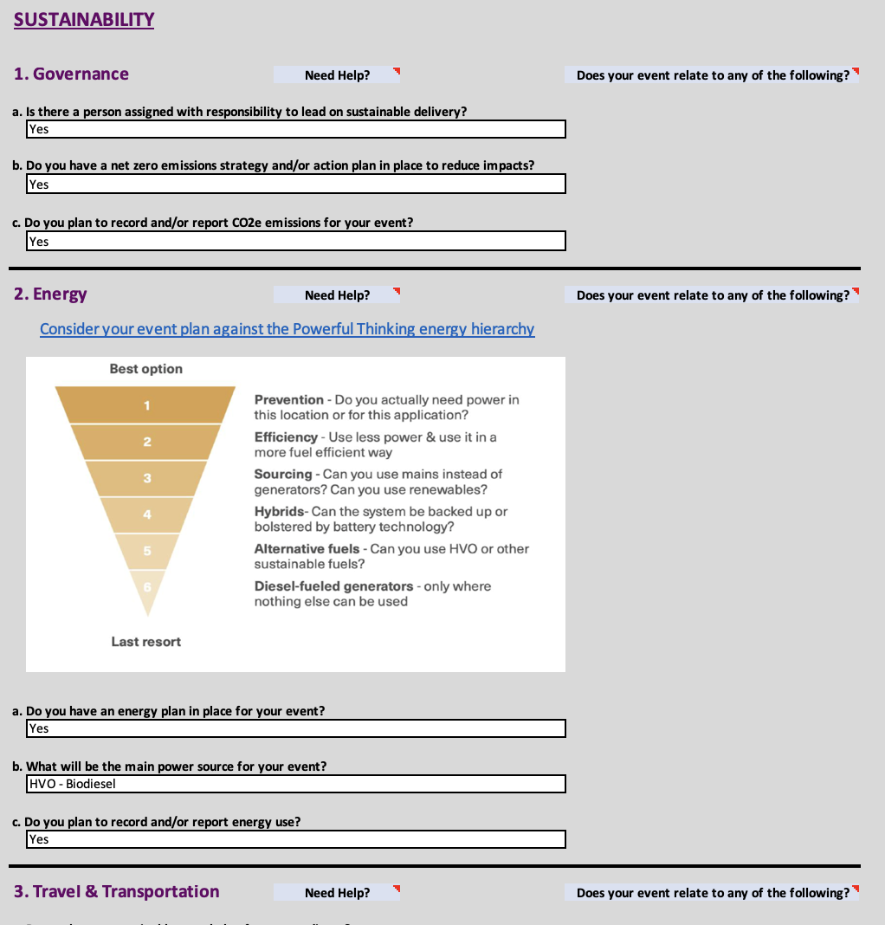
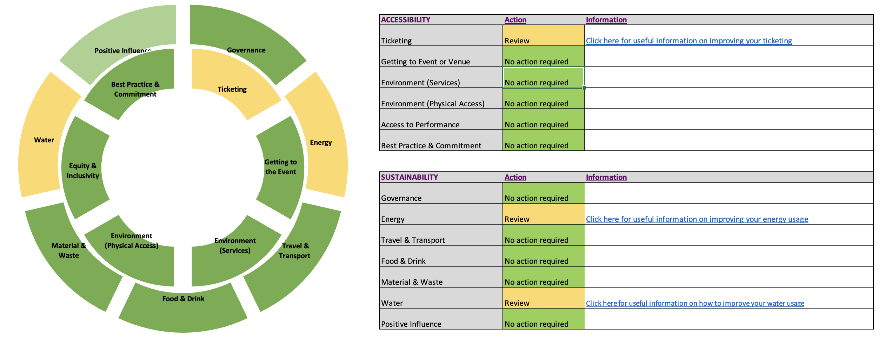
What is DATE?
DATE is a simple toolkit that works within the events commissioning process to deliver:
An assessment of an event’s accessibility and sustainability profile
Information and support for event organizers
Dynamic model for data analysis
The tool has been purposely designed to be:
Accessible to all
Easily integrated into OAUK events context
Accurate, inexpensive and adaptable
DATE takes the form of a three-page survey that produces everything needed to assess an events profile against the Green Events Code, as well as providing additional accessibility and social value outputs for local authorities.

Slide 5
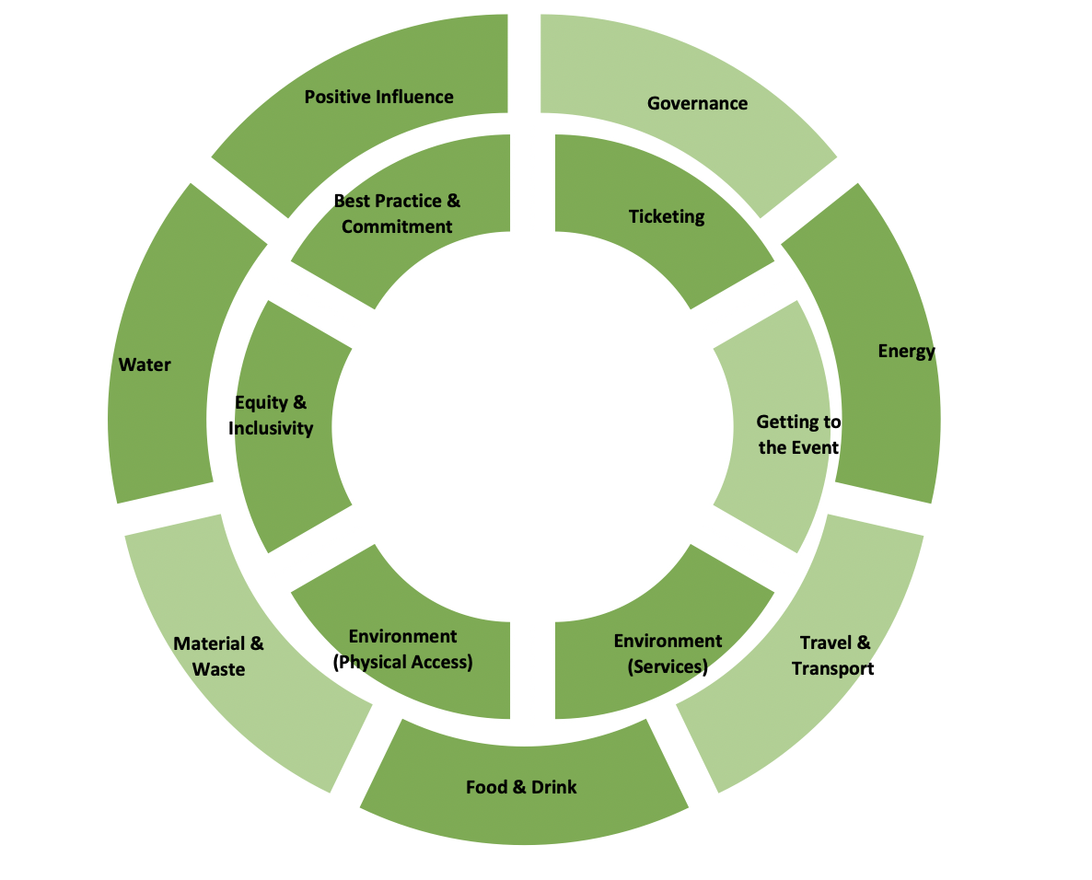
How does DATE work?
The DATE toolkit combines four key elements:
Green Events Code of Practice (Outer ring)
Attitude is Everything Charter (Inner ring)
Project Assessment Tool
“Doughnut” ethos
These work together to create an easy-to-use integrated tool that is:
easy to use for events organisers who are not experts on measuring impacts.
within the ability/capacity of even small voluntary run events to use
clear and simple in he picture it provides to those making assessments
Easily integrated in systems and data secure

Slide 6
Where does DATE work?
DATE can be integrated at any point of the event planning process.
Event plan
Advisory process
Review
Action
Advisory report to help improve sustainability and accessibility of event; signposting to information and community support
Event reporting incorporating the GECOP & AIE frameworks, tailored to each event and authority

Slide 7
When does DATE work?
OAUK Session
Testing and use
?
Action
2024

Slide 8
Preparation: Toolkit Requirements
To think about:
How do we complete your toolkit?
Question Pages
Summary and recommendations
Action

Slide 9
National Context
Policy recommendations
Advisories for event organizers (SVM)
Review funding / budget allocation
Reporting for Events Commissioning / SAG
Aggregated analysis
Identify Local/regional/ national priorities
UK pilot
Dataset for each local authority
Dynamic reporting & modelling; enforcement data
Dataset for sector
Growth Agnostic / Social & environmental value focus
Identification
Analysis
Evaluation

Slide 10
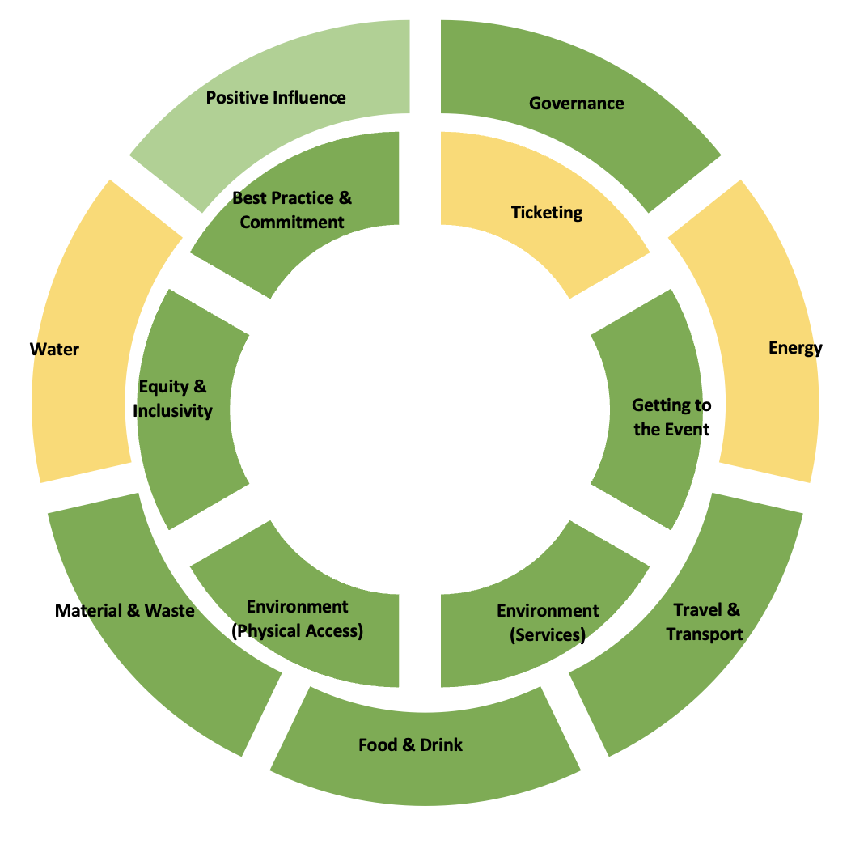
Demonstration

Slide 11
Questions?

